Slide 1
Taking apart Slocum G3
Science Bay

Slide 2
Side view of science bay

Slide 3
Forward view of science bay

Slide 4
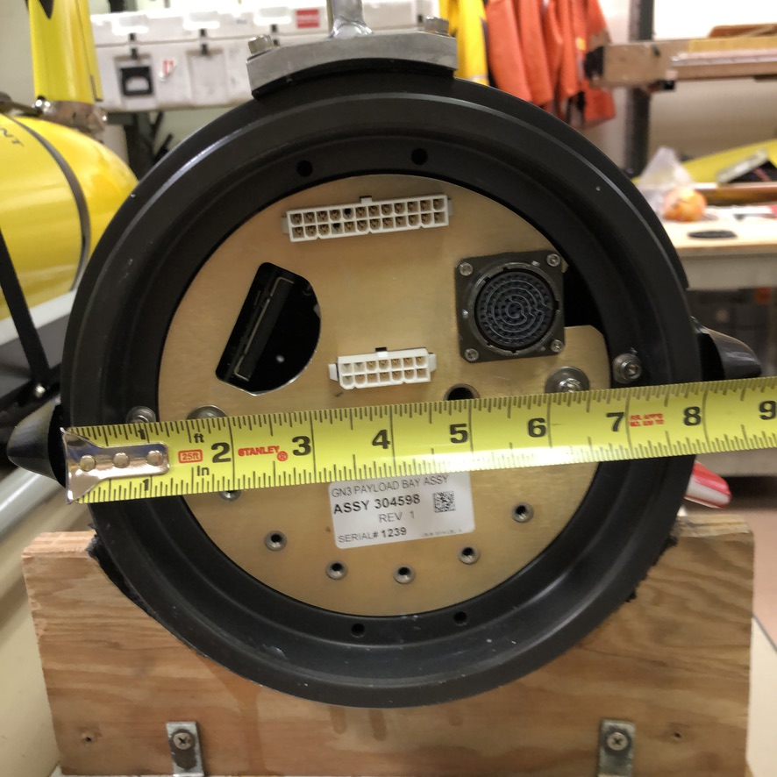
Aft view of science bay

Slide 5
Foam for resting science bay on

Slide 6
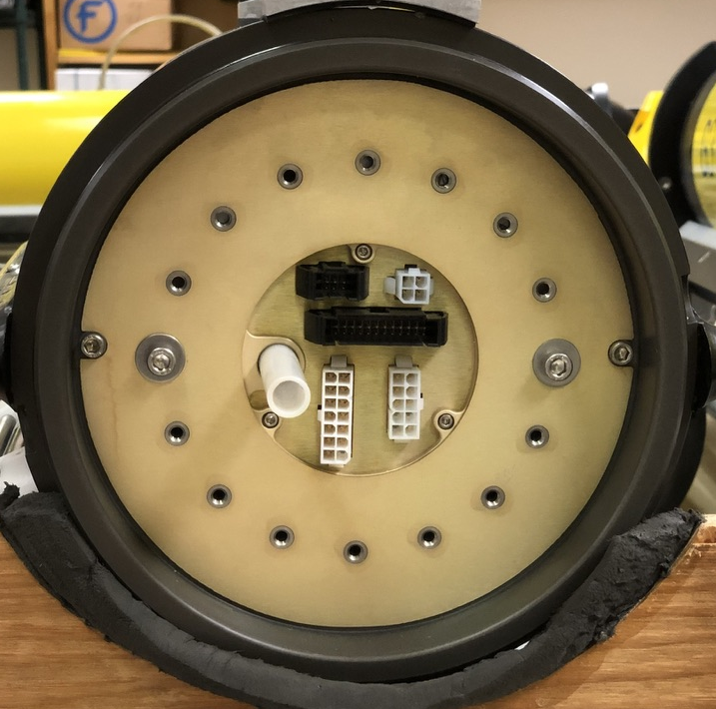
Forward section with plate removed, 2 screws

Slide 7
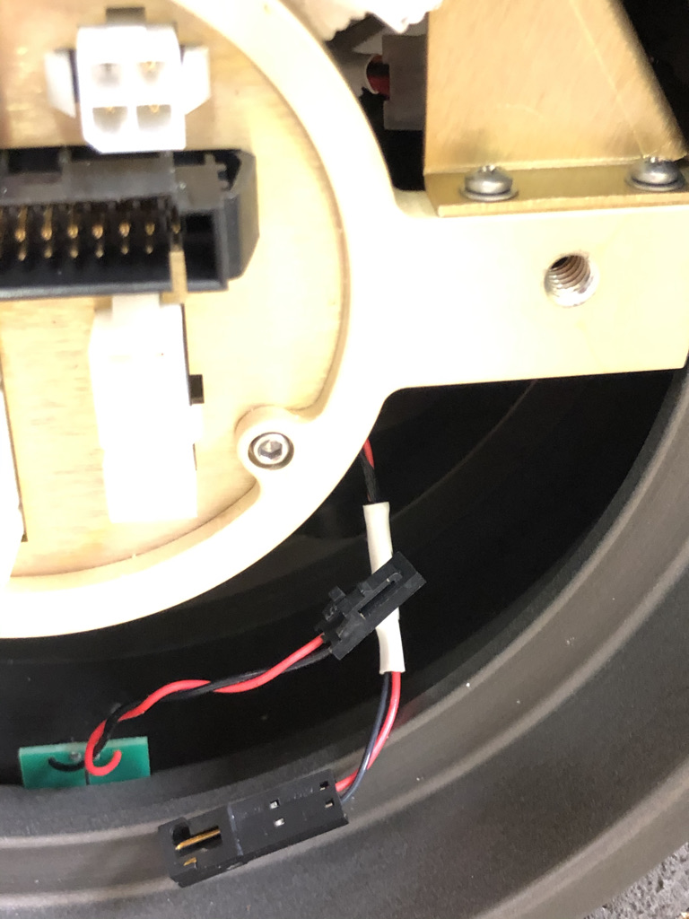
Disconnected leak sensor

Slide 8
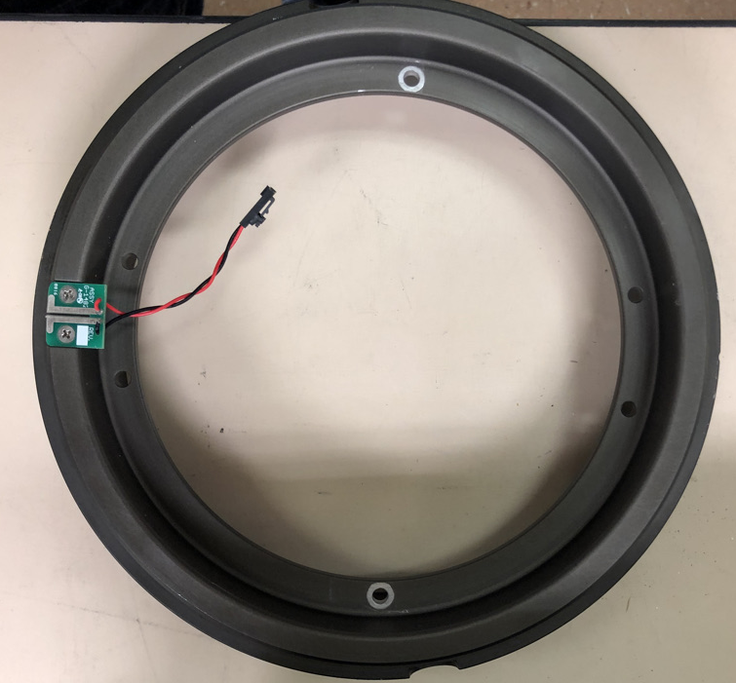
Remove forward bulkhead ring, 2 screws

Slide 9
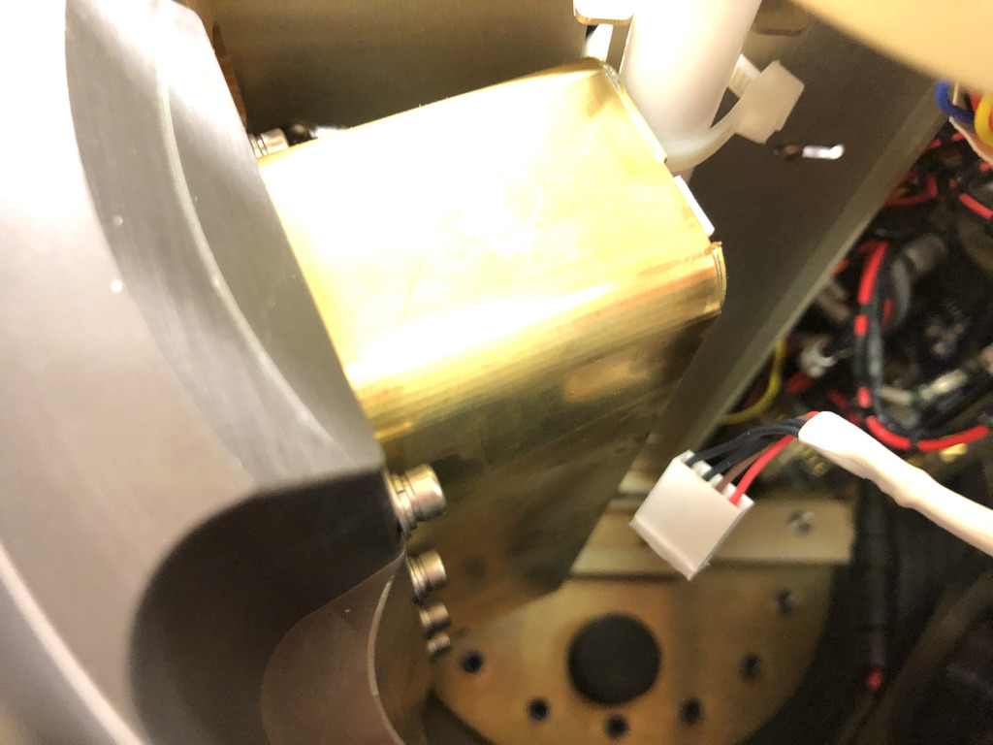
Disconnect CTD cable

Slide 10
Remove 3 screws holding connector plate

Slide 11
Remove 2 screws holding angle plate

Slide 12
Remove structural cross plot

Slide 13
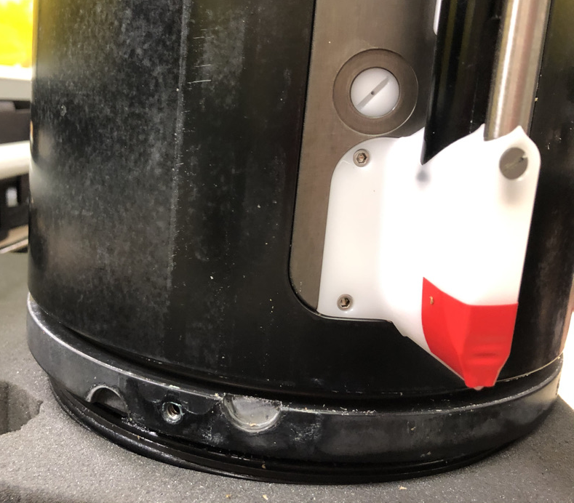
Remove science hull from aft ring

Slide 14
Science bay with CTD

Slide 15
Science internals with fore ring installed for structural integrity and HDPE tuve removed.

Slide 16
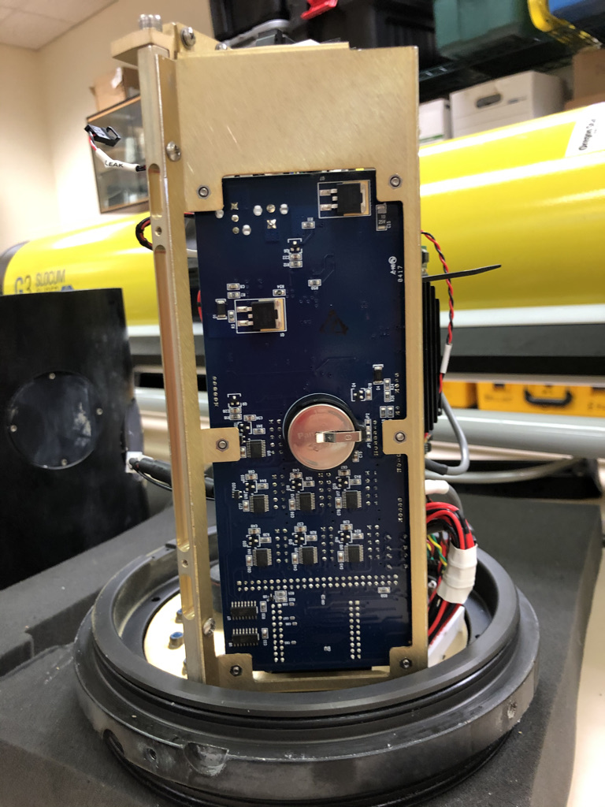
Science Board

Slide 17
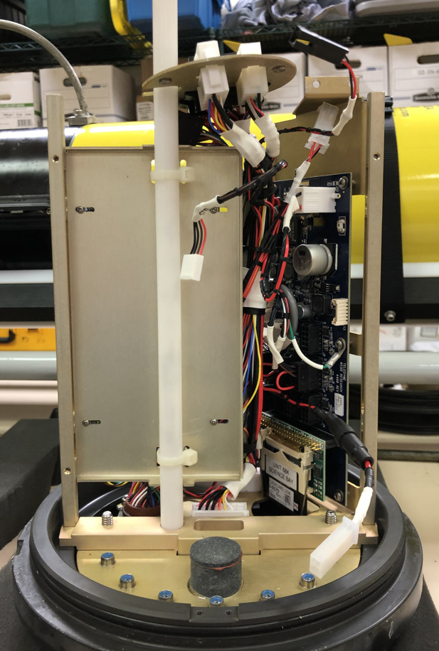
uModem Board and tray

